Slide 1
Request of Proposal of SW PRODUCT
MAIN ROBOTICS PROCESSING AND COMMUNICATIONS UNIT
~Team AI-nonymous
Swathi D
Raajshree Bharathi
Raj Suriyan
Akhil Jayaraman

Slide 2
ABSTRACT
Designed a system based on a ROS2–style decentralized robotic architecture, where each subsystem functions as an independent module communicating over structured publish–subscribe channels. A central supervisor handles coordination, health monitoring, and safety management across these distributed units, following the same architectural principles used in ROS 2.
Running on a Linux-based processing platform, the system architecture is intended to interface with real robotic communication buses such as CANopen, Ethernet, LVDS, and Optical links, typically used to connect external modules P2, P3, and P4.

Slide 3
OBJECTIVE
To ensure safe and reliable operation, the central robotics controller(CRC) includes a comprehensive Safety, Logging, and Monitoring (SLM) framework, responsible for real-time system evaluation. This framework implements:
  Heartbeat Monitoring: Continuous heartbeat exchange with P2, P3, and P4 to detect connectivity failures or silent node crashes.
  Diagnostics Collection: Periodic acquisition of CPU, memory, and disk health parameters from all distributed modules, enabling condition-based monitoring.
  • Live map status: Detection of the movements and directions using live map tracking
  Alerts & Fault Detection: Automated detection of abnormal conditions such as heartbeat timeout, resource exhaustion, or communication loss, with immediate alerts and sound notifications.
  Dashboard Visualization: A real-time web dashboard, implemented using FastAPI, MQTT, and Chart.js, visualizes heartbeat graphs, diagnostics history, timestamps, and system alerts with audio alarms for critical faults.
  Cloud Integration Ready: The architecture includes a publish–subscribe communication backbone via MQTT, enabling seamless remote streaming of logs, health metrics, and safety events to cloud services for long-term analytics.

Slide 4
ARCHITECTURE OUTLINE
The implemented method adopts a distributed simulation approach, where P2, P3, and P4 operate as independent modules continuously publishing heartbeat and diagnostics information.
The controller aggregates, processes, and analyzes this data through a central monitoring controller and displays it on a fully dynamic dashboard capable of real-time graphing, alerting, and historical trend analysis.
This layered approach provides a fail-safe, modular, and extensible monitoring ecosystem suitable for industrial robots, autonomous vehicles, and safety-critical embedded platforms, ensuring high reliability through continuous health assessment, live-tracking, proactive fault detection, and robust communication management.

Slide 5
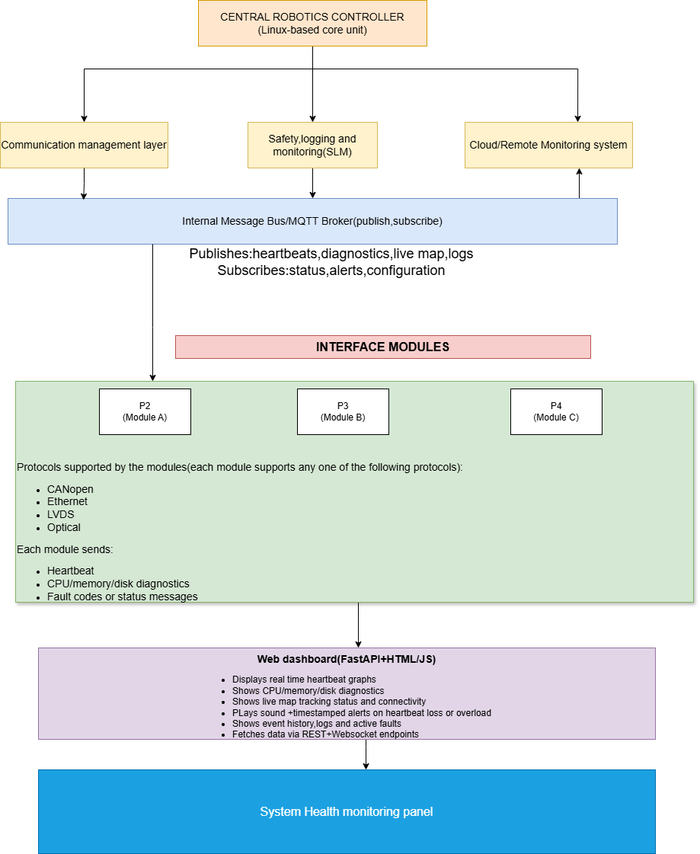
ARCHITECTURE

Slide 6
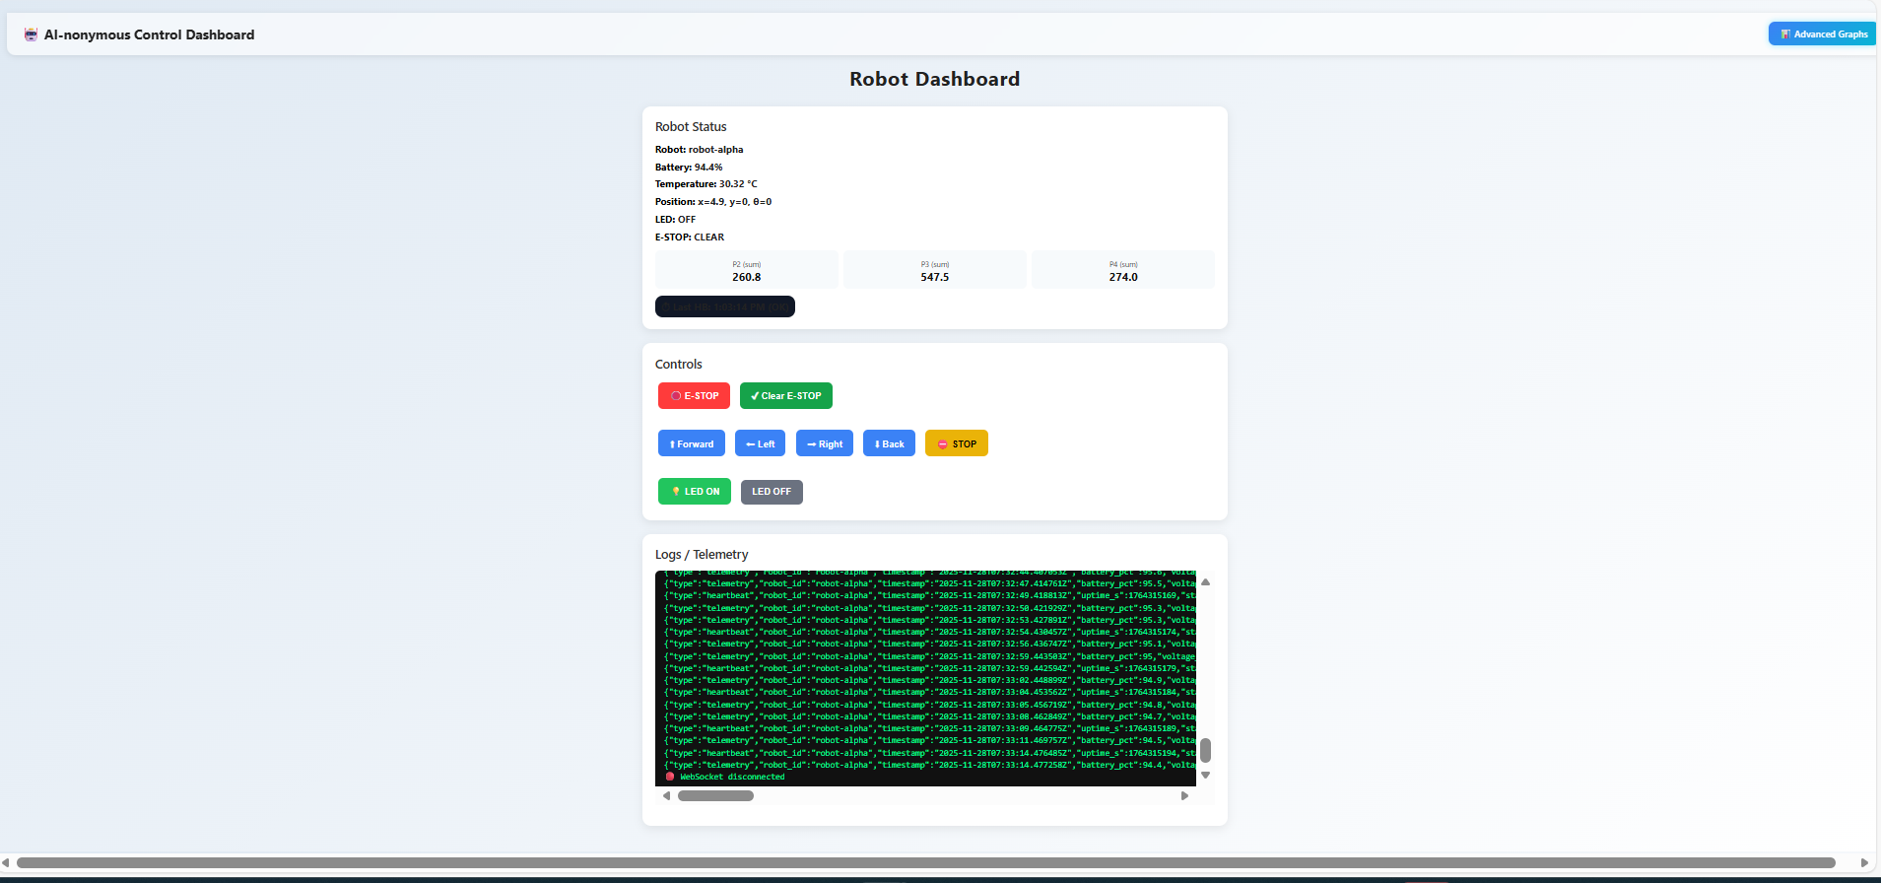
OUTPUT
DASHBOARD

Slide 7
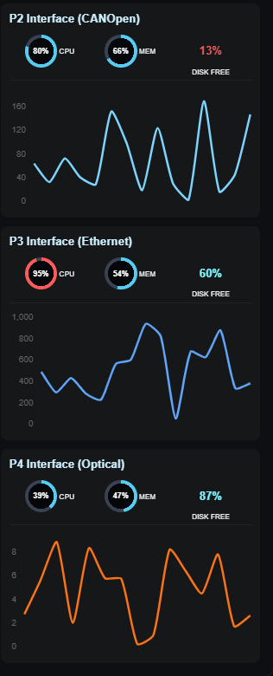
CPU, memory, disk tracking for each interface
OUTPUT

Slide 8
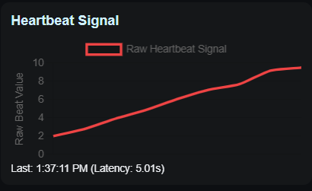
Heartbeat monitoring
OUTPUT

Slide 9
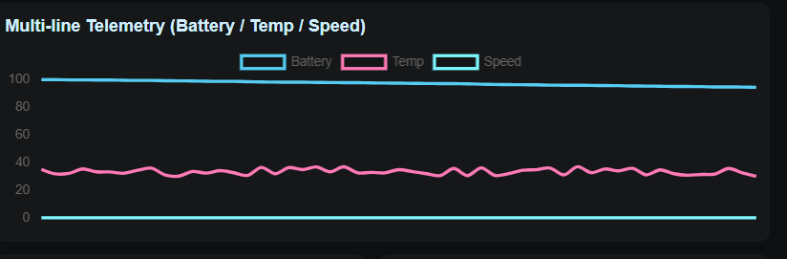
Battery, temperature and speed monitoring
OUTPUT

Slide 10
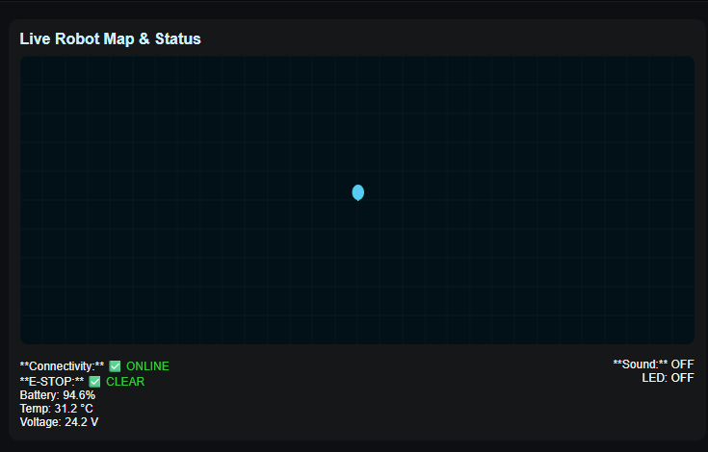
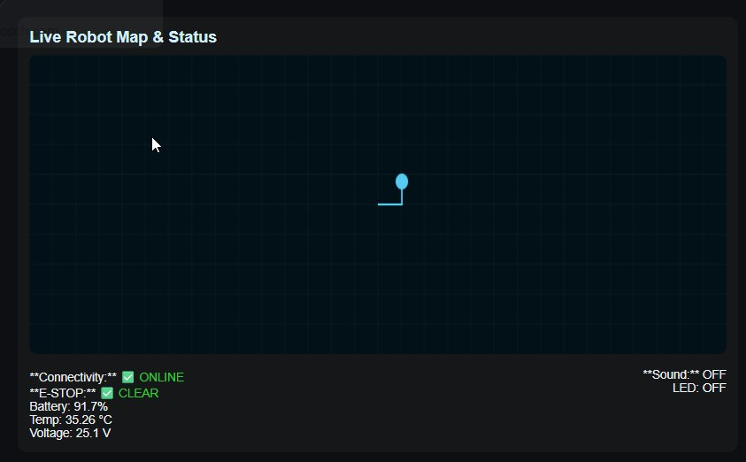
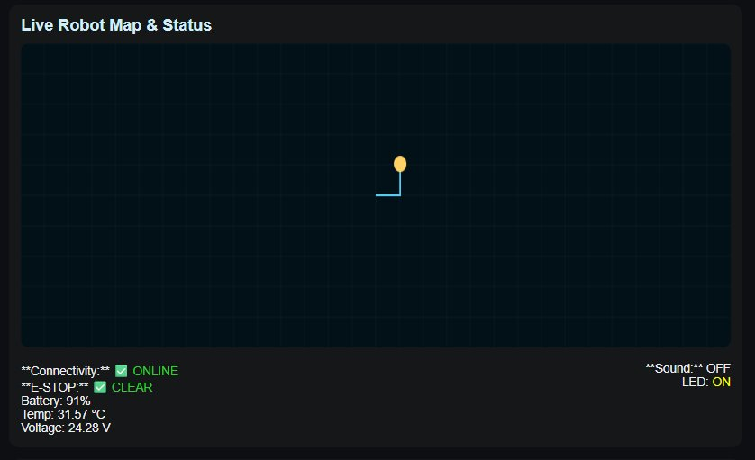
OUTPUT
Live map tracking and status
1.Live robot map and status(in rest mode)
2.Robot status with movement
3.Movement with LED on

Slide 11
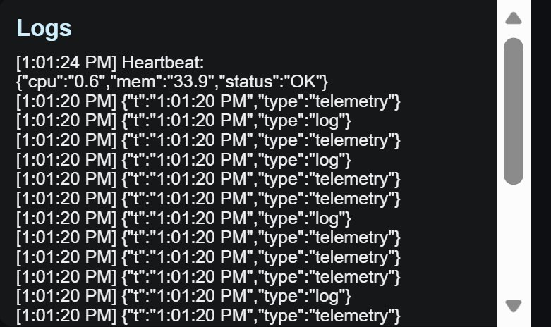
Logs with timestamp
OUTPUT

Slide 12


